Slide 1
EVEREST II
Study Design
Multicenter
Randomized in a 2:1 ratio to either percutaneous or conventional surgery for the repair or replacement of the mitral valve (MV)
273 patients with moderately severe or severe (grade 3+ or 4+) mitral regurgitation (MR)
Primary Composite Endpoint
Efficacy defined as freedom from death, surgery for MV dysfunction, and grade 3+ or 4+ MR at 12 months
Primary Safety Endpoint
A composite of major adverse events within 30 days

Slide 2
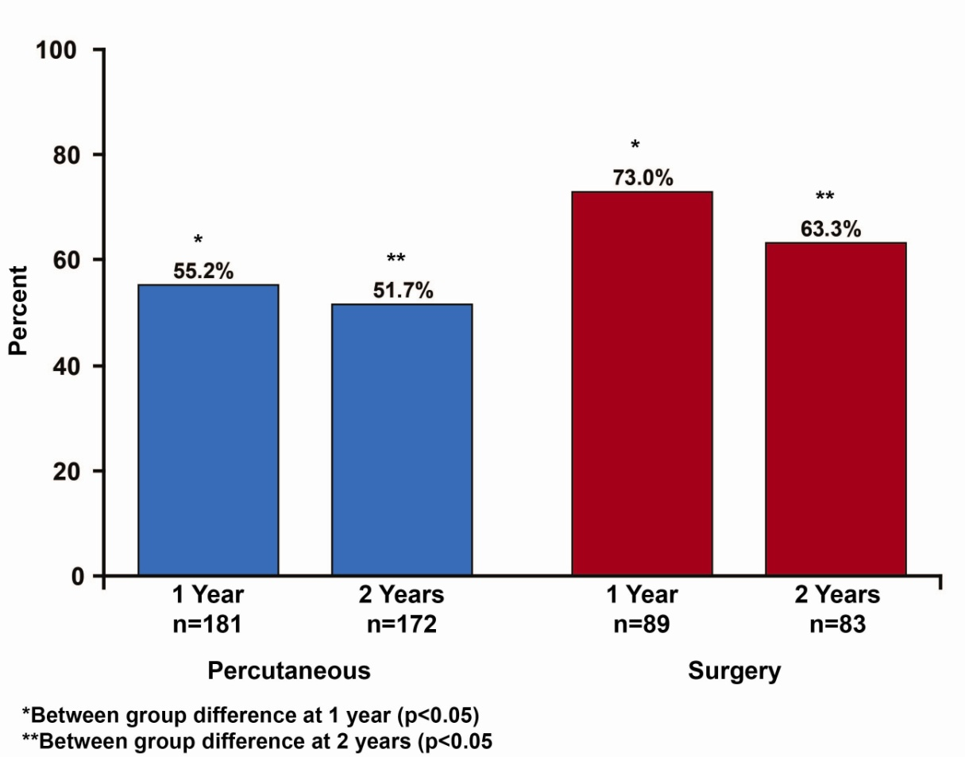
EVEREST II
Results
55% efficacy in the percutaneous repair group vs 73% in the surgery group (p=0.007)
No difference in mortality rates (6% for both groups
Surgery, MV repair was 20% in the percutaneous group vs 2% in the surgery group (p<0.001)
Grade 3+ or 4+ mitral regurgitation was similar (21% in the percutaneous group vs 20% in the surgery group)
The rate of major adverse events at 30 days was 15% in the percutaneous group vs 48% in the surgery group (p<0.001)
Primary Effectiveness at 1and 2 Years

Slide 3
EVEREST II
Conclusions
Year 1 results showed that percutaneous repair was less effective at reducing MR than conventional surgery but that the procedure was associated with superior safety and similar improvements in clinical outcomes
Year 2 results demonstrate overall stability in outcomes over the second year of follow-up and no device failures were observed over this period
Longer-term follow-up information will be helpful in assessing the durability of catheter-based MV repair

